Slide 1

Logic University Stationery Store Inventory System
Presented by Team 4

Slide 2
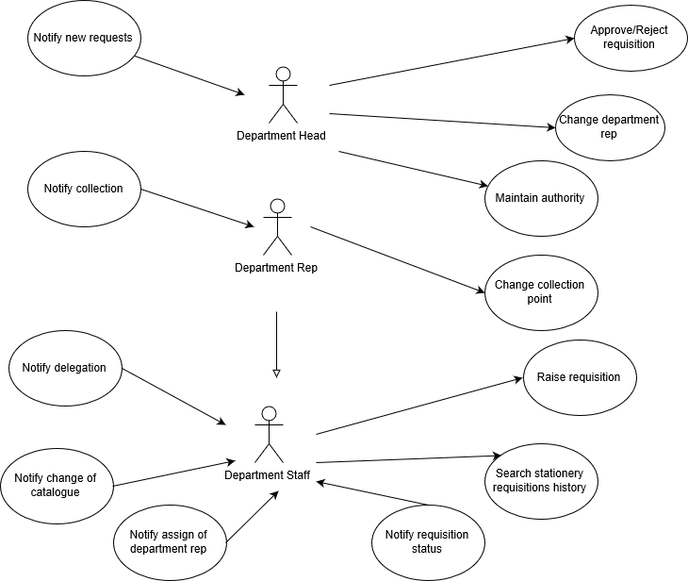
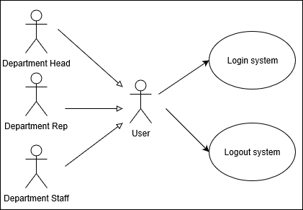
Use Case Diagram

Slide 3
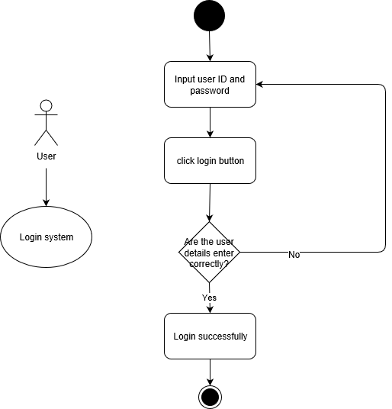
Login system

Slide 4

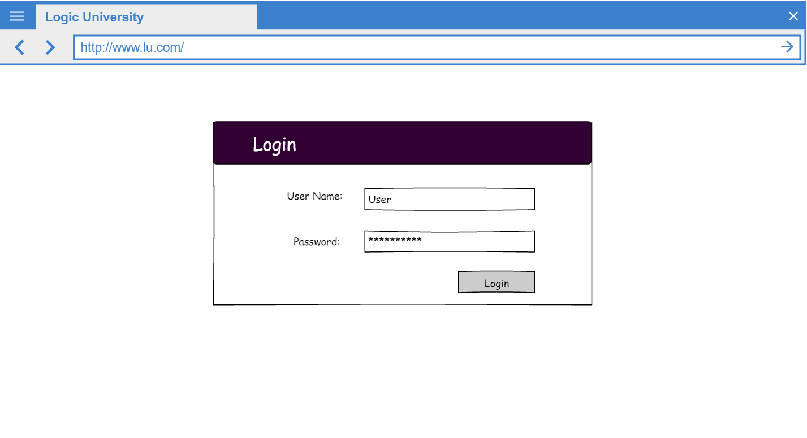
Login system

Slide 5

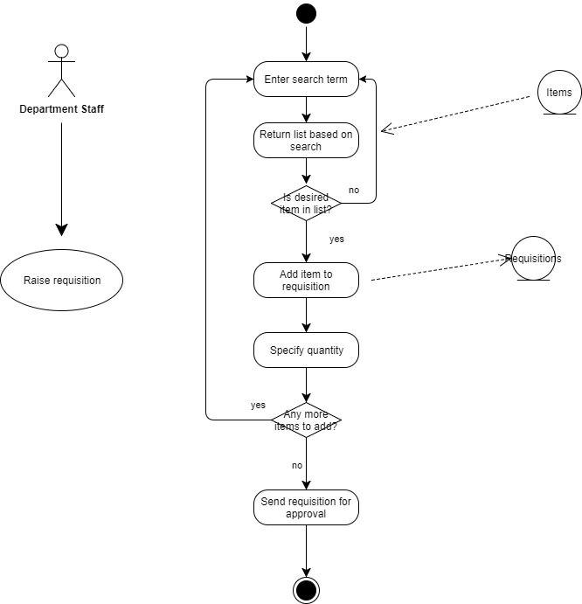
1. Raise Requisition

Slide 6
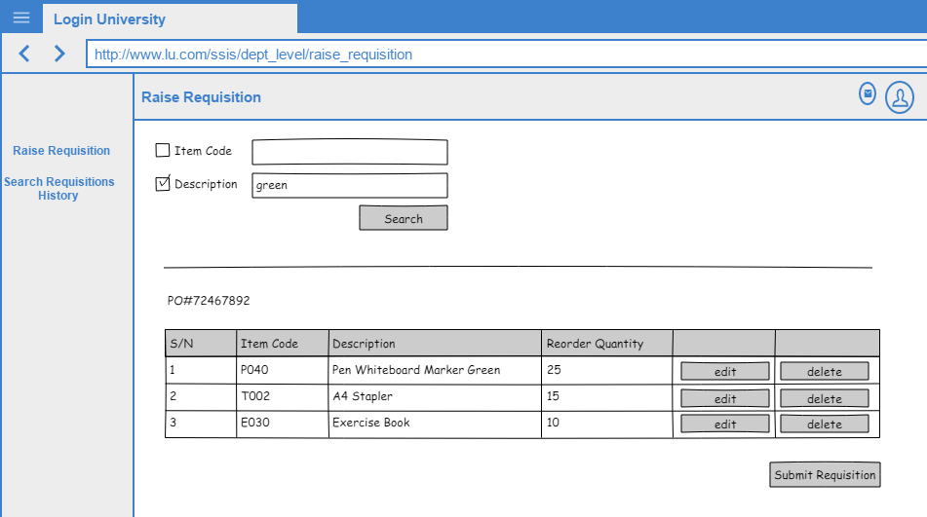
1. Raise Requisition

Slide 7
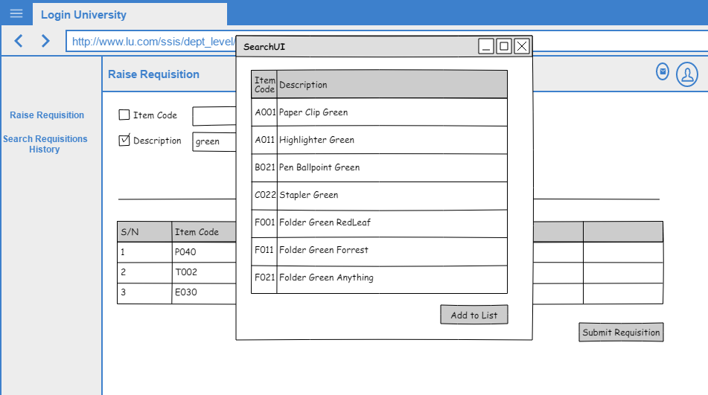
1. Raise Requisition

Slide 8
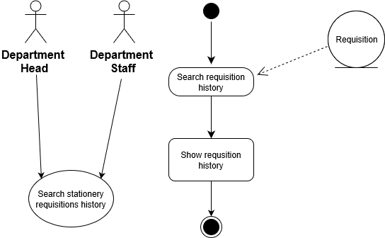
2. Search stationery requisition history

Slide 9
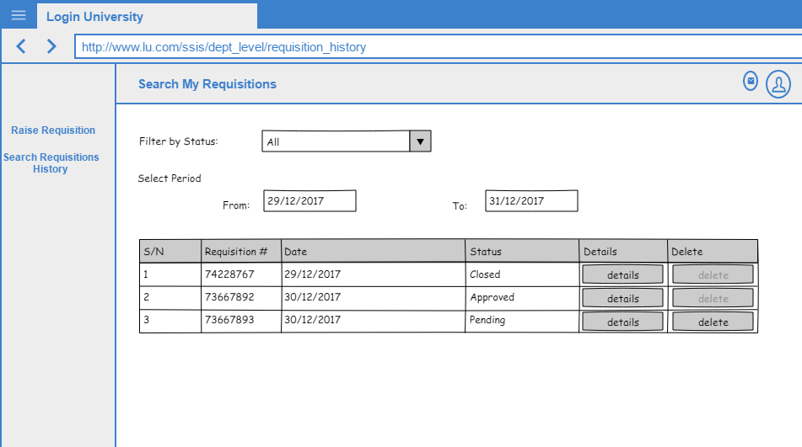
2. Search stationery requisition history

Slide 10
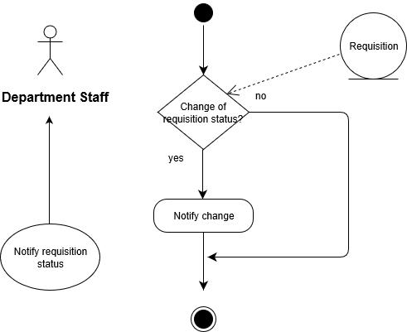
3. Notify requisition status

Slide 11
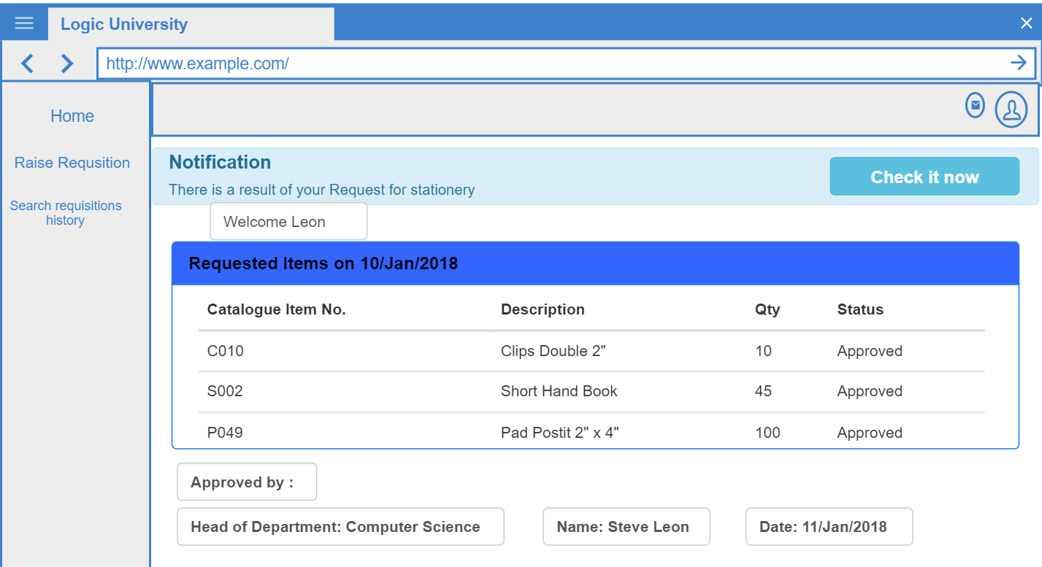
3. Notify requisition status

Slide 12
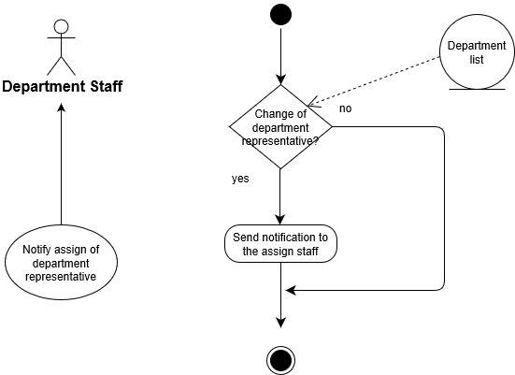
4. Notify Assign of department Representative

Slide 13
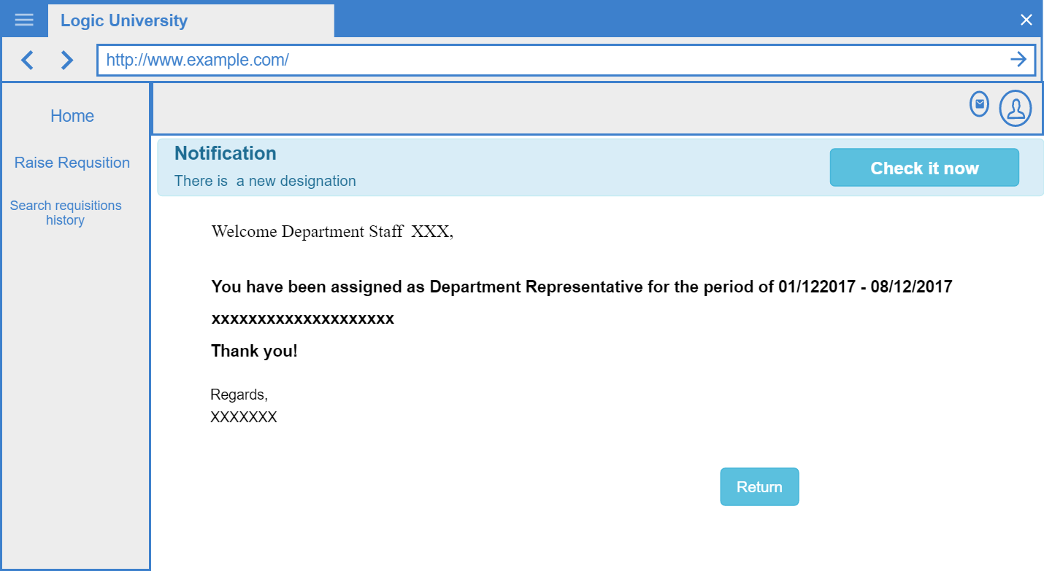
4. Notify Assign of department Representative

Slide 14
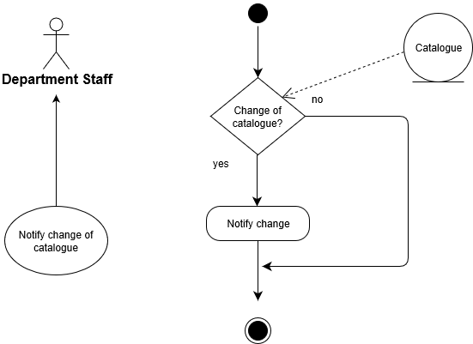
5. Notify change of catalogue

Slide 15
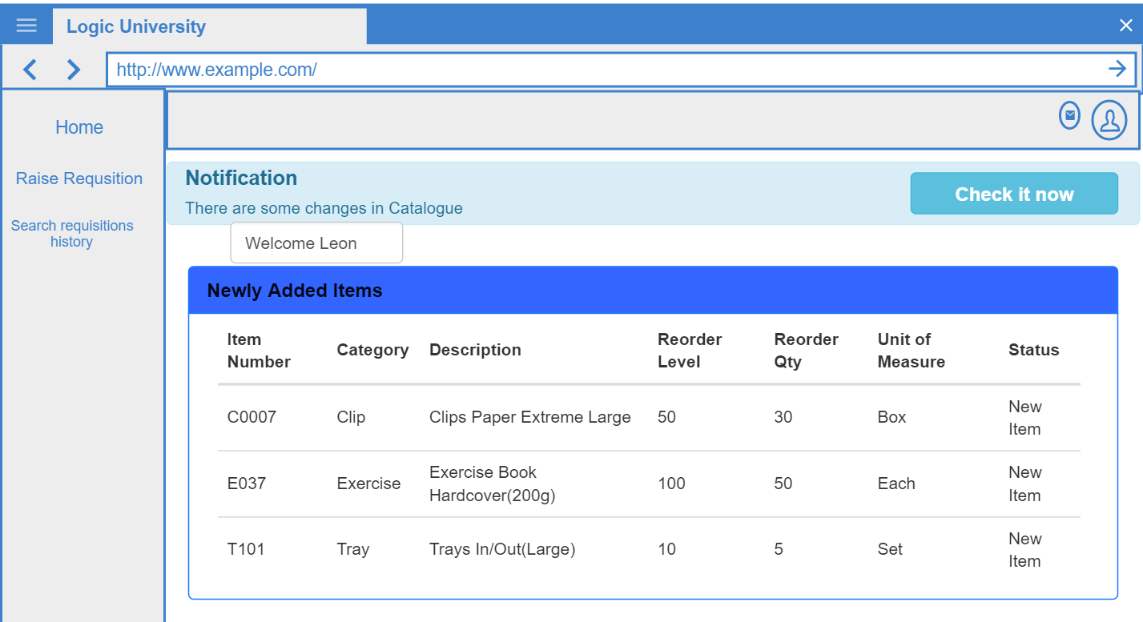
5. Notify change of catalogue

Slide 16
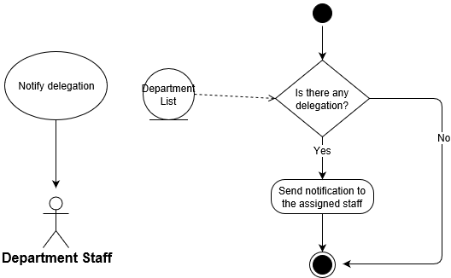
6. Notify delegation

Slide 17
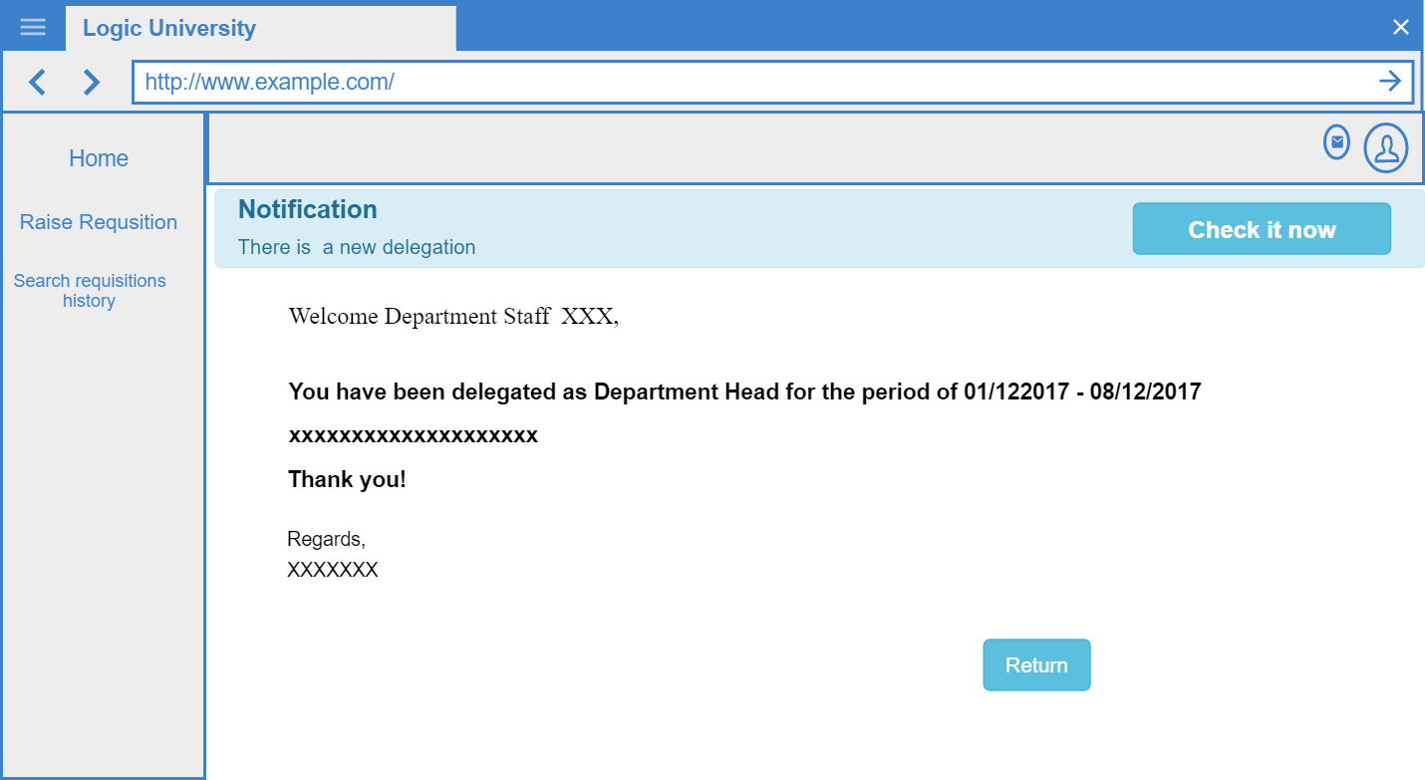
6. Notify delegation

Slide 18

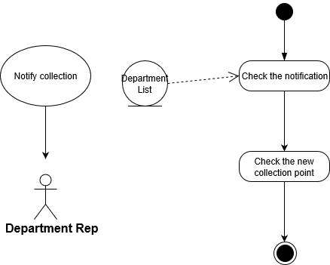
7. Notify collection

Slide 19
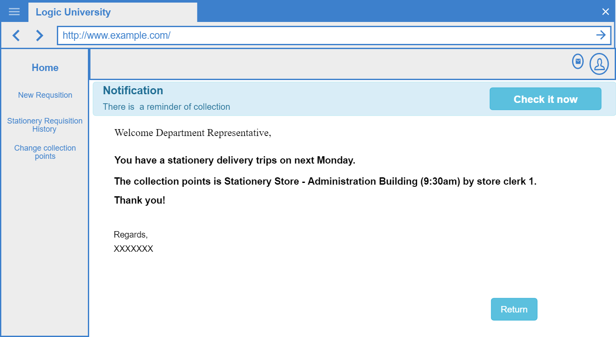
7. Notify collection

Slide 20
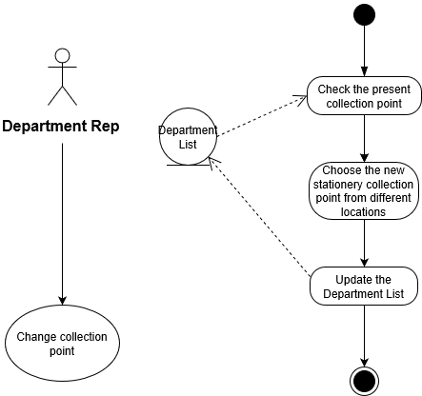
8. Change collection point

Slide 21
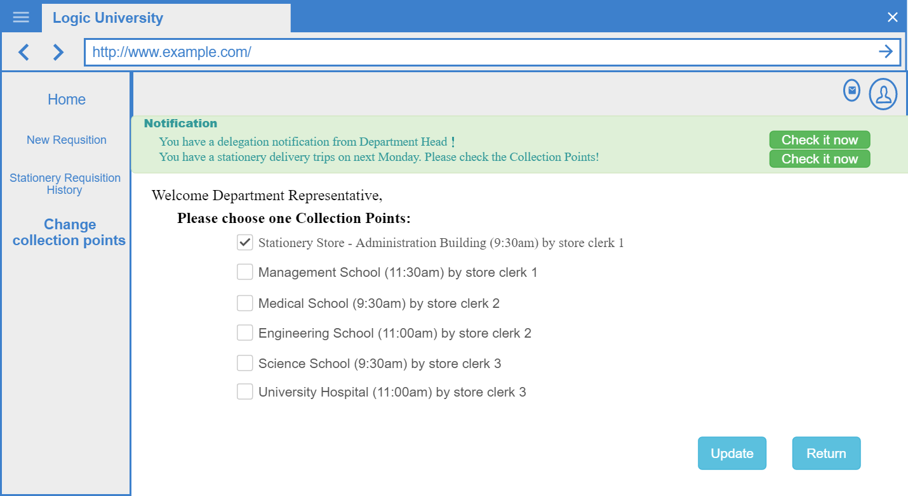
8. Change collection point

Slide 22

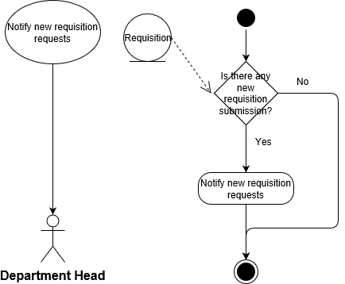
9. Notify new requisition requests

Slide 23
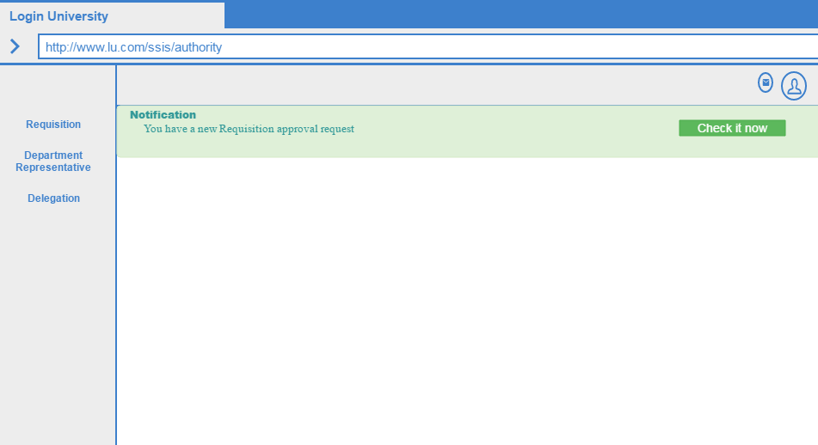
9. Notify new requisition requests

Slide 24
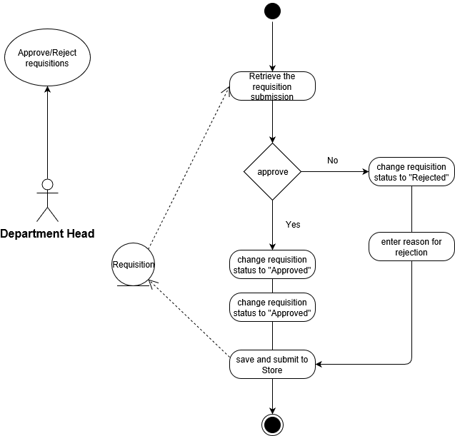
10. Approve/ Reject requisitions

Slide 25
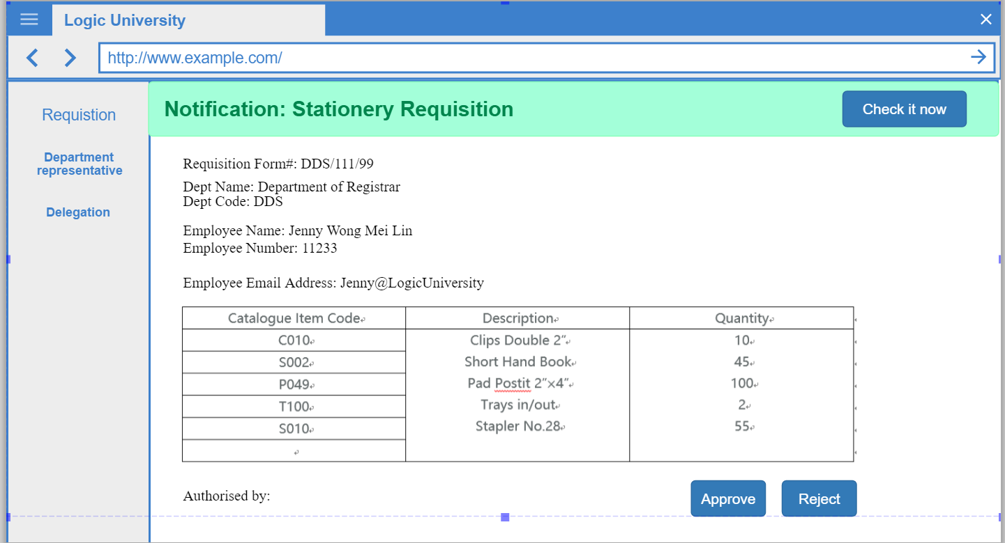
10. Approve/ Reject requisitions

Slide 26
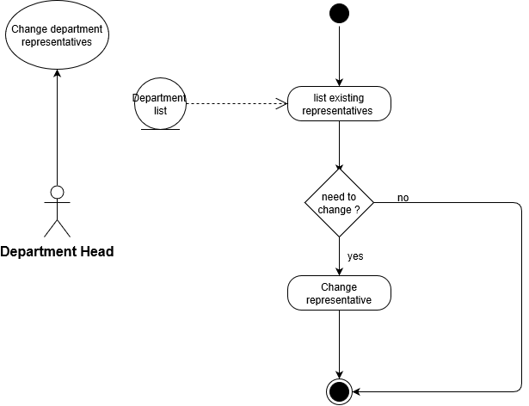
11. Change department representatives

Slide 27
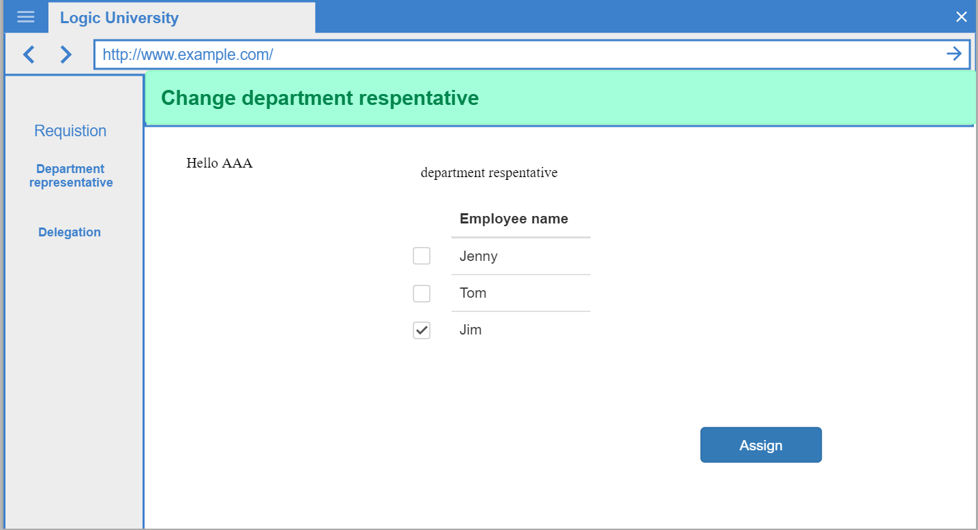
11. Change department representatives

Slide 28
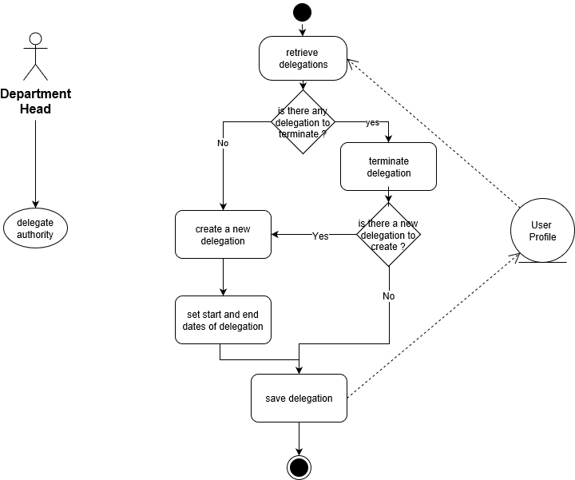
12. Delegate authority

Slide 29
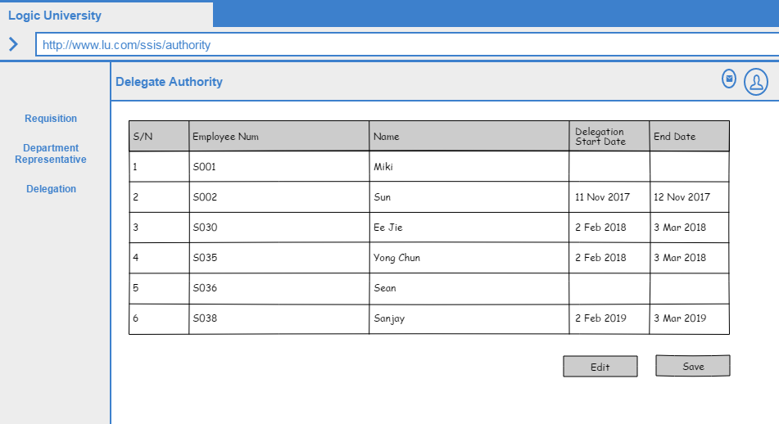
12. Delegate authority

Slide 30
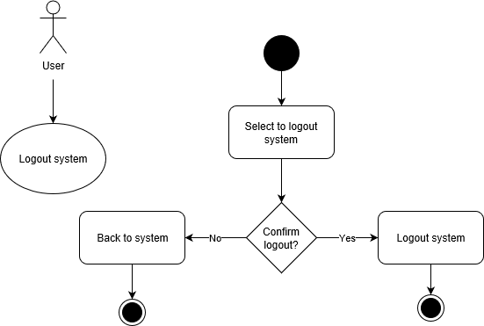
Logout system

Slide 31
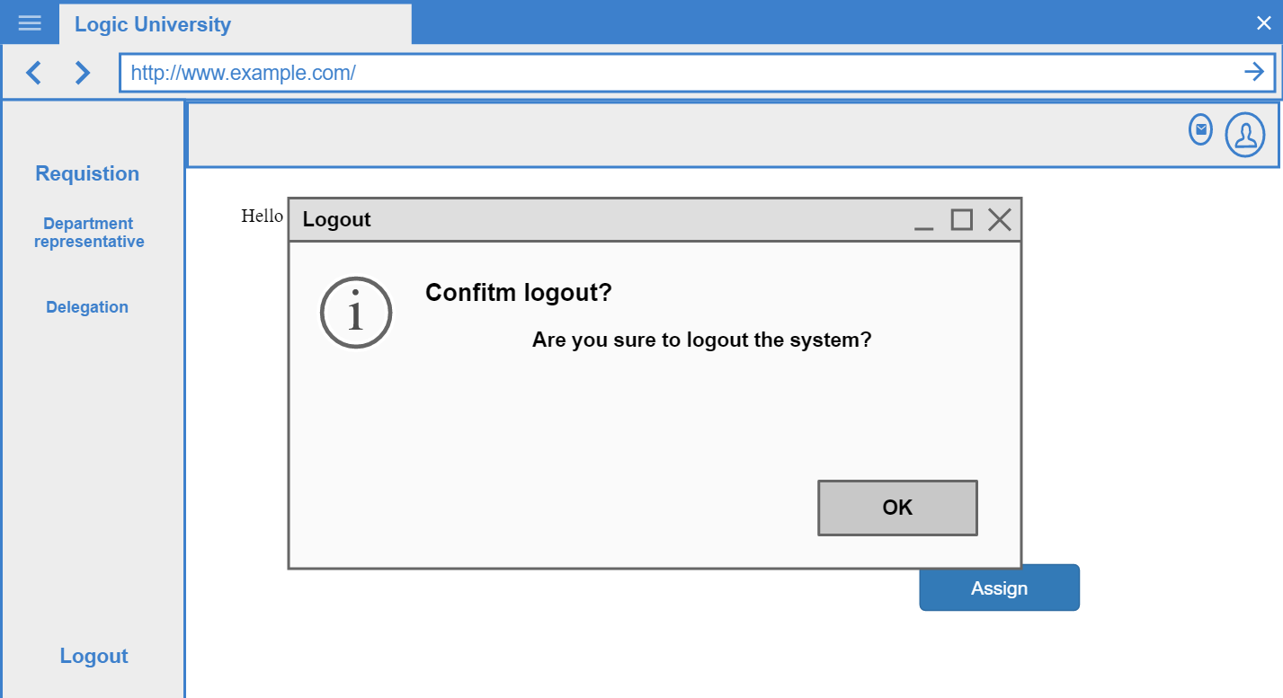
Logout system

Slide 32

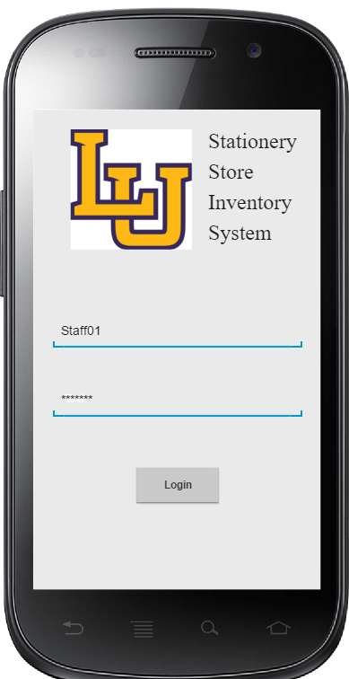
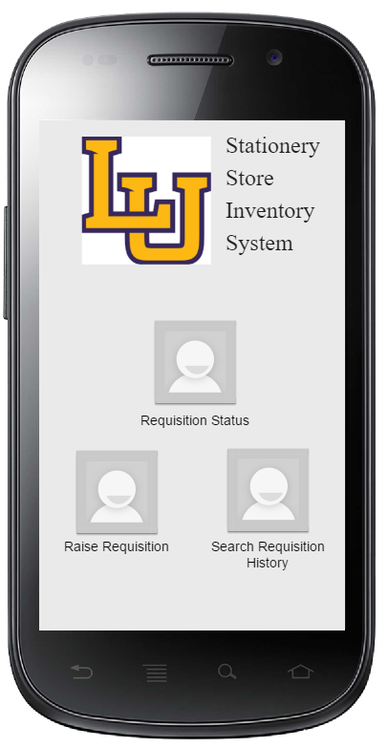
Login system
Login page
Dashboard

Slide 33
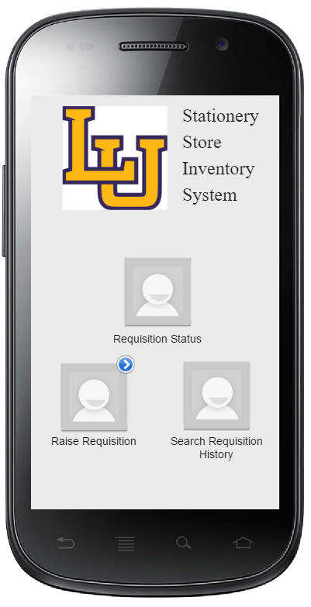
1. Raise Requisition
Clicking on Raise requisition
Opens up the Raise
Requisition page

Slide 34
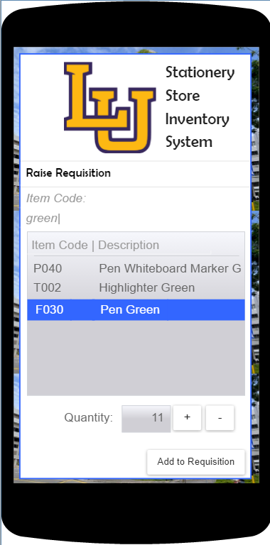
1. Raise Requisition
Raise requisition page
Item codes, description and the quantity are indicated.
The Add to Requisition button is clicked.
This will open up a Raise Requisition submission page.

Slide 35
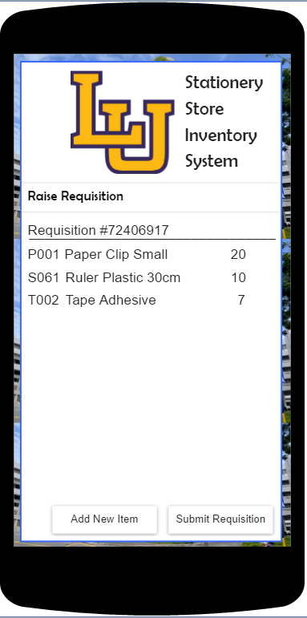
1. Raise Requisition
Raise requisition submission page
If department staff has to add more items, the user will be reverted to the raise requisition page.
If the department staff wishes to confirm requisition, the submit requisition button will be clicked.

Slide 36
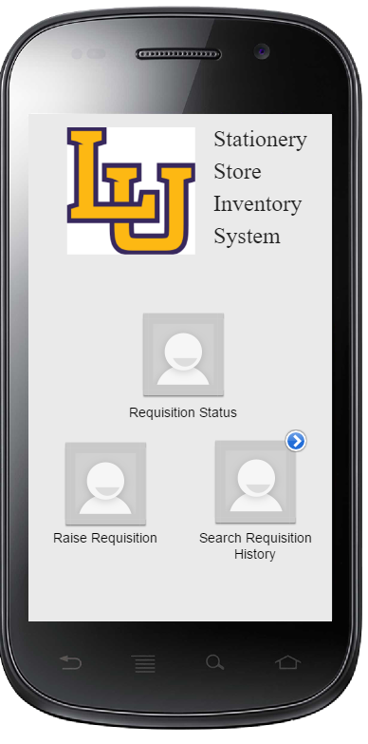
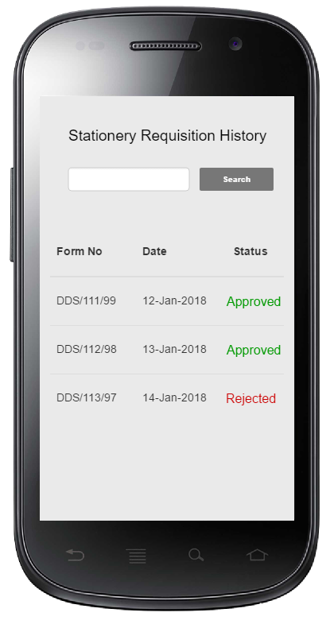
2. Search stationery requisition history
Clicking on search requisition history button shows a list of all requisition forms in the past

Slide 37
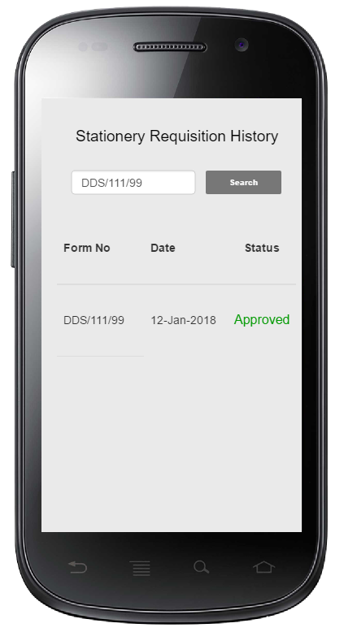
2. Search stationery requisition history
Searching based on form number, date, or status will give a list of the forms matching the search criteria

Slide 38
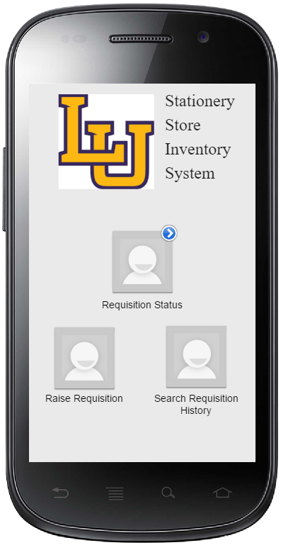
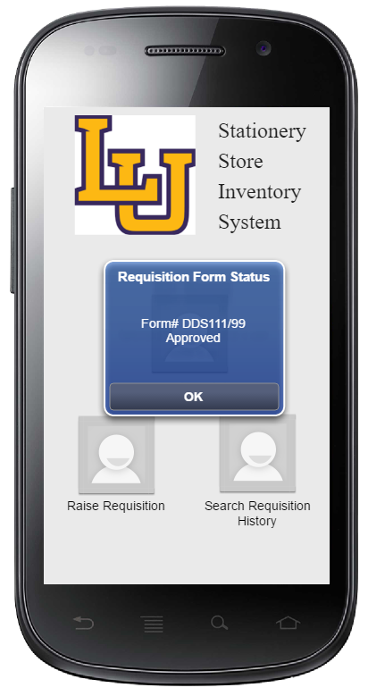
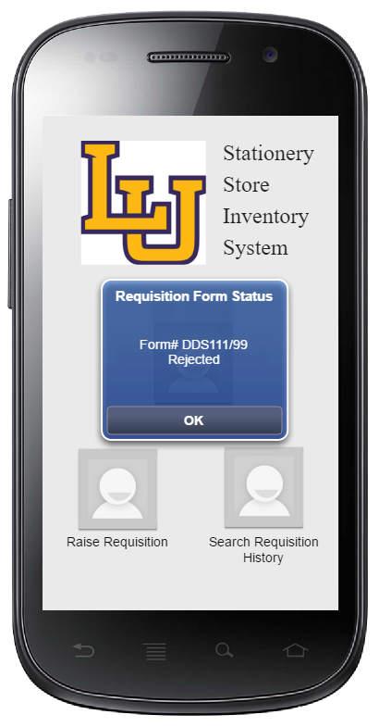
3. Notify requisition status
When a notification appears, clicking on requisition status button causes a pop up box to appear to show status of requisition form raised.

Slide 39
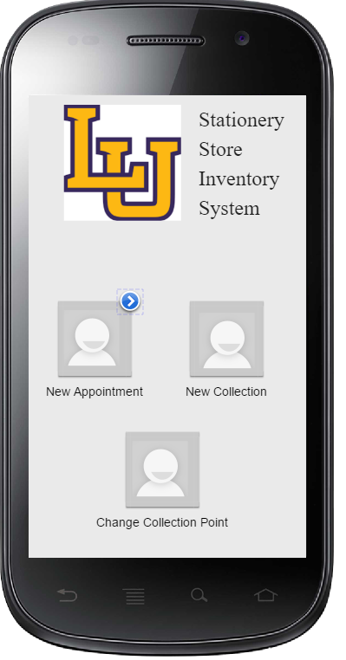
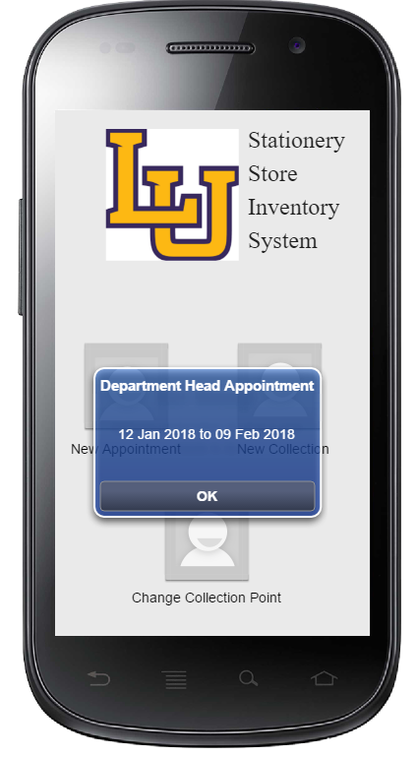
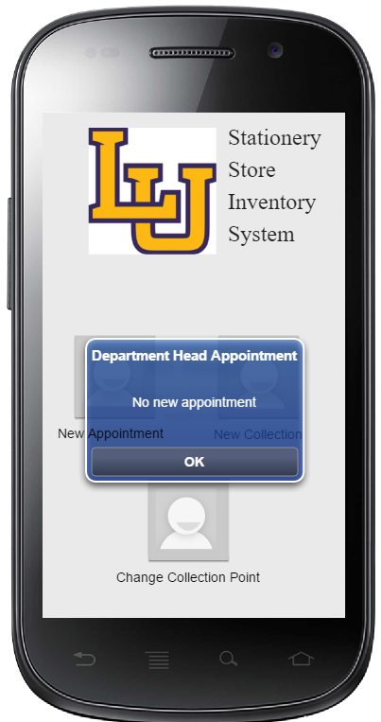
6. Notify delegation
If there’s a new appointment
If there’s no new appointment

Slide 40
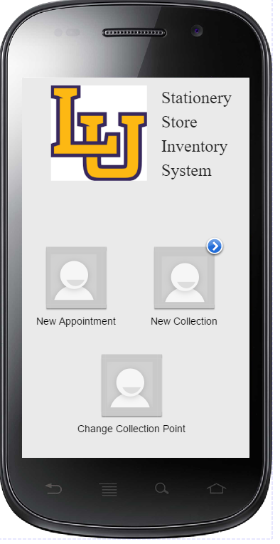
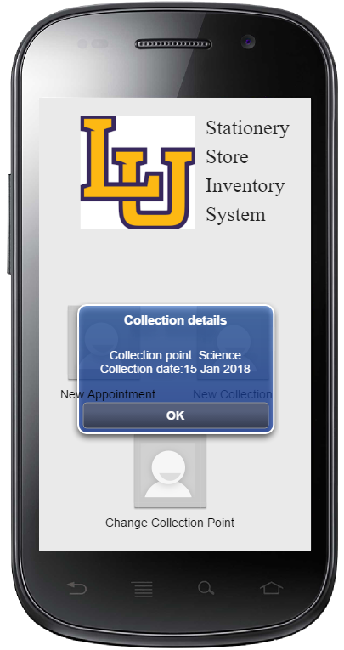
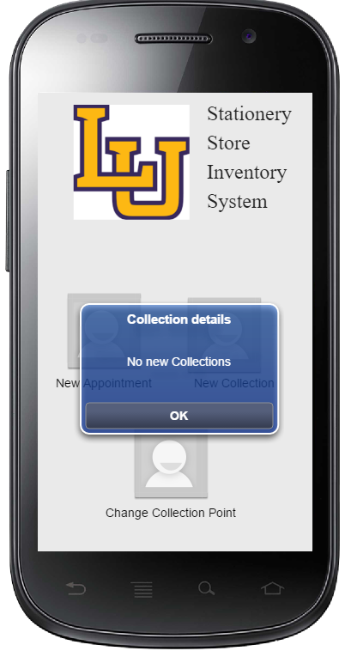
7. Notify collection
If there’s a new collection
If there’s no new collection

Slide 41
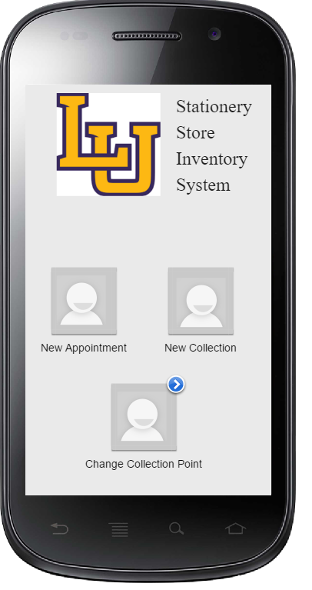
8. Change collection point

Slide 42
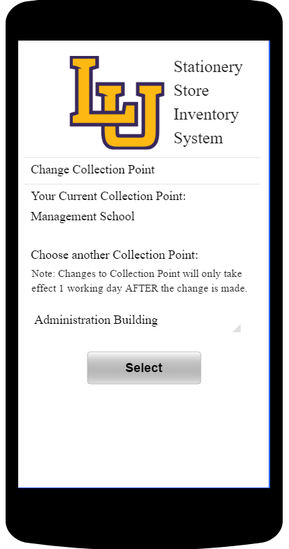

8. Change collection point
Clicking on the spinner will show a drop down list where a new collection point can be selected

Slide 43



9. Notify new requisition requests
Clicking on new requests icon will open up the new requests page
New Requests page
Clicking on Request item will open up Stationery requisition page (as shown)

Slide 44

10. Approve/ Reject requisitions
Clicking on approve will open up a confirmation dialogue box.
Clicking on reject will open up a confirmation dialogue box.

Slide 45


11. Change department representatives
The current label beside the
Staff shows the staff who is currently appointed as the
current department rep
Clicking on Appoint Dept Rep opens up the staff list page

Slide 46

11. Change department representatives
Sliding the staff row to the left will reveal the appoint button. This button is for appointment of new staff or to change appointment to new staff.
Once appoint button clicked, the new staff will now have the current status label.

Slide 47

12. Delegate authority
The current label beside the
Staff shows the staff who is currently appointed as the
temporary department
head
Clicking on Delegate Authority icon opens up the staff list page

Slide 48

12. Delegate authority
Sliding the staff row to the left will reveal the appoint button. This button is for appointment of new staff or to change appointment to new staff.

Slide 49

12. Delegate authority
Once appoint button has been clicked, staff will be redirected to the staff list page.
Here, the department head can set the start and end date for the staff’s temporary appointment and click approve.

Slide 50

12. Delegate authority
Once the approve button has been clicked, the department head can confirm if he wants to confirm the appointment.

